Slide 1

A Deep Learning Model to detect breast cancer metastasis

Slide 2
About Us
Group Members
Usama Baig 143979
Muhammad Mahad Khan 125254
Khalid . 126131
* BESE-6A
Advisor: Dr. M. Shahzad
Co-Advisor: Dr. Qaiser Riaz

Slide 3
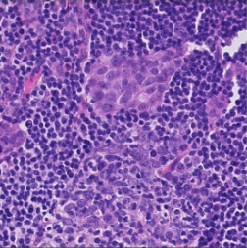
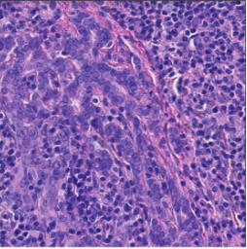
Can you tell which one contains tumor?
THAT IS THE REAL QUESTION…

Slide 4
Problem

Slide 5



About Breast Cancer
Detection Techniques
Stage Determination
Treatment
Ultrasound
Mammogram
Magnetic Resonance Imaging (MRI)
Biopsy
Stage 0
Stage 1
Stage 2
Stage 3
Stage 4
Radiotherapy
Chemotherapy
Surgery
https://www.pinkribbon.org.pk/stages-breast-cancer/

Slide 6
Problem
Hard to scan Whole Slide Image (WSI) manually
Very Large GIGAPIXEL Images (WSI) (10⁶ x 10⁶)
Up to 30 hours
per Slide
Classical computing methods are not robust
https://arxiv.org/abs/1606.05718
Notes:
REASONS

Slide 7
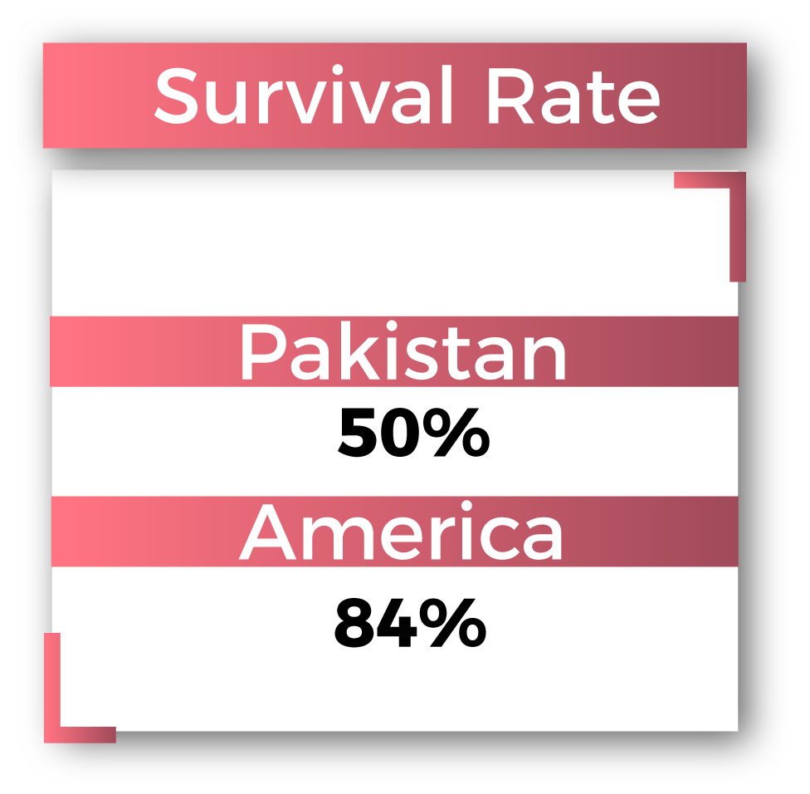
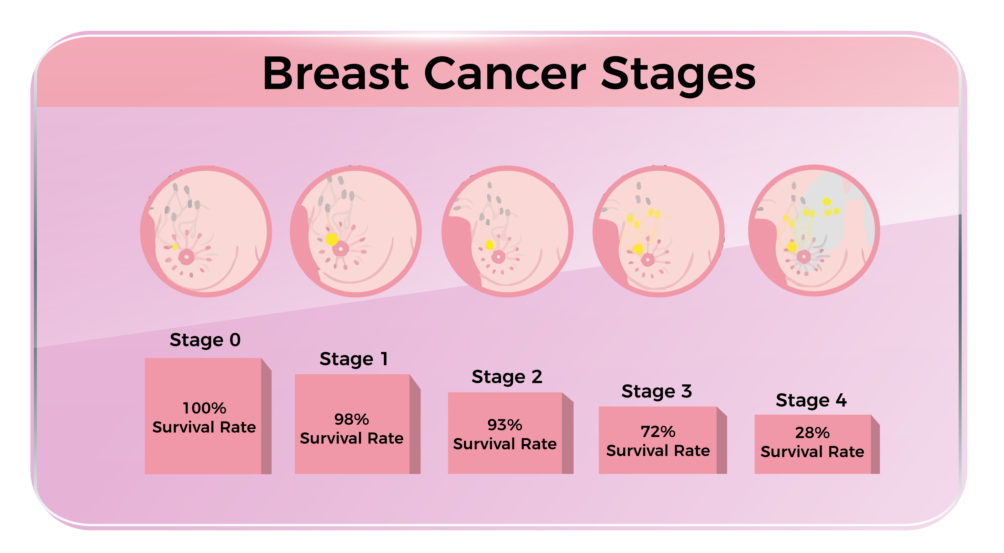
Problem
10.21 % diagnosis accuracy at Stage-1
https://www.thenews.com.pk/print/375948-over-83-000-breast-cancer-cases-in-pakistan-every-year/

Slide 8
Our Solution

Slide 9



Our Solution
Catanet : Deep learning based classification pipeline.
Slide-Level
Classification of WSI
Localization of Tumor
Stage Detection
Presence of Tumor
Severity of Cancer
Patient-Level

Slide 10
Why Catanet?
Fits perfectly in the pathologist’s diagnosis pipeline

Slide 11
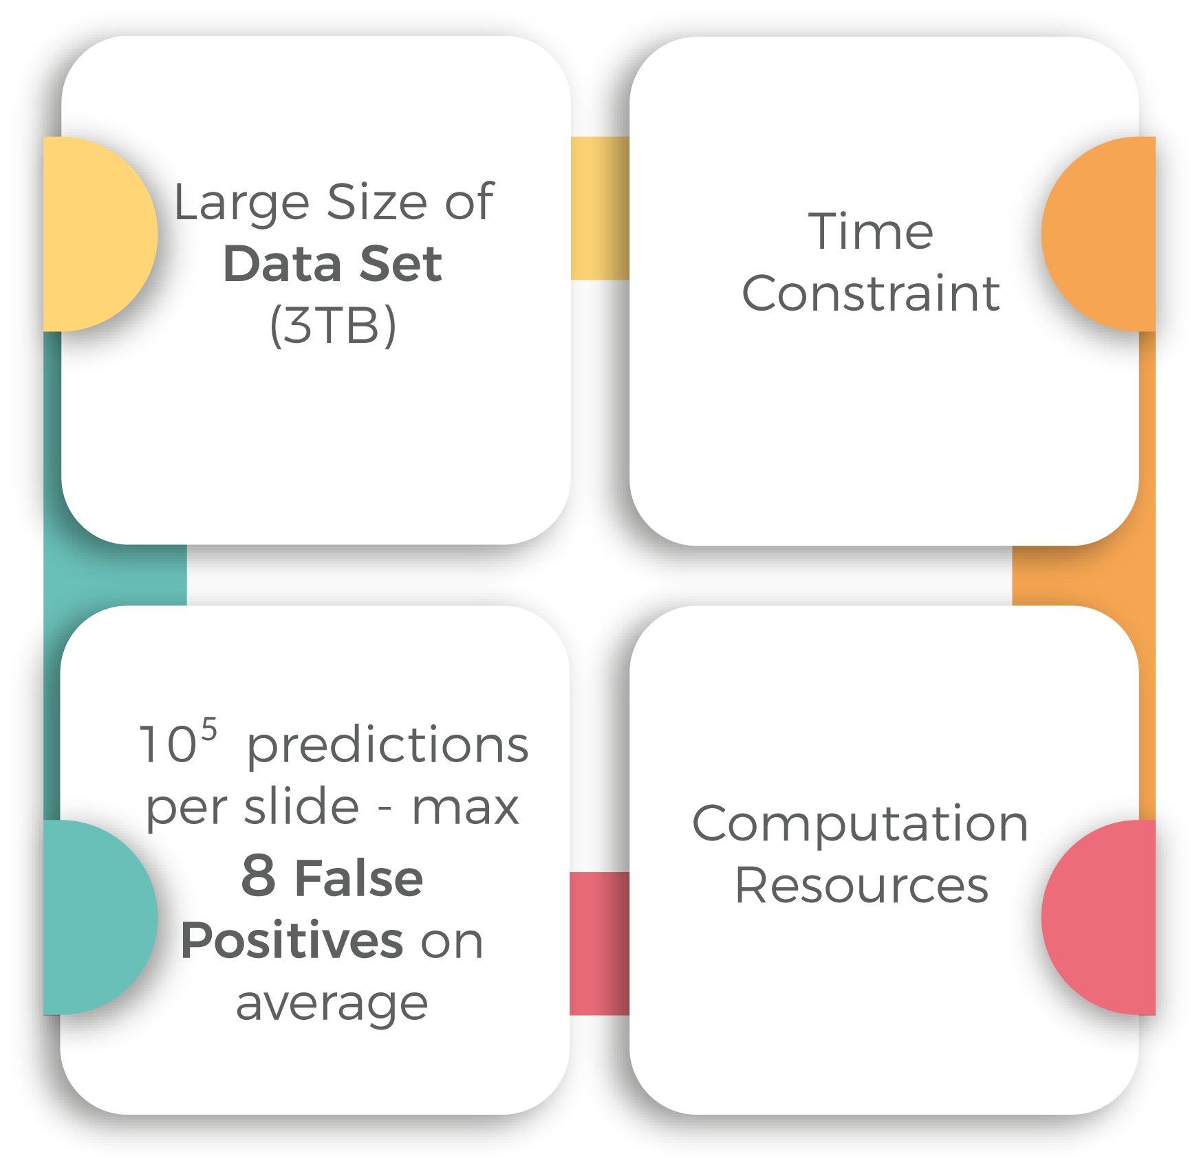
Constraints in Implementation

Slide 12
Literature Review
Machine Learning:
Szegedy, C. et al(2015). Going deeper with convolutions. 2015 IEEE Conference on Computer Vision and Pattern Recognition (CVPR), 1-9.
Szegedy, C., Ioffe, S., & Vanhoucke, V. (2016). Inception-v4, Inception-ResNet and the Impact of Residual Connections on Learning. AAAI.
He, K., Zhang, X., Ren, S., & Sun, J. (2016). Deep Residual Learning for Image Recognition. 2016 IEEE Conference on Computer Vision and Pattern Recognition (CVPR), 770-778
Deep Learning for Cancer Detection:
Wang, D., Khosla, A., Gargeya, R., Irshad, H., & Beck, A.H. (2016). Deep Learning for Identifying Metastatic Breast Cancer. CoRR, abs/1606.05718.
Liu, Y., Gadepalli, K., Norouzi, M., Dahl, G.E., Kohlberger, T., Boyko, A., Venugopalan, S., Timofeev, A., Nelson, P.Q., Corrado, G.S., Hipp, J.D., Peng, L.H., & Stumpe, M.C. (2017). Detecting Cancer Metastases on Gigapixel Pathology Images. CoRR, abs/1703.02442.
Steiner, D.F., MacDonald et al (2018). Impact of Deep Learning Assistance on the Histopathologic Review of Lymph Nodes for Metastatic Breast Cancer. The American journal of surgical pathology.

Slide 13
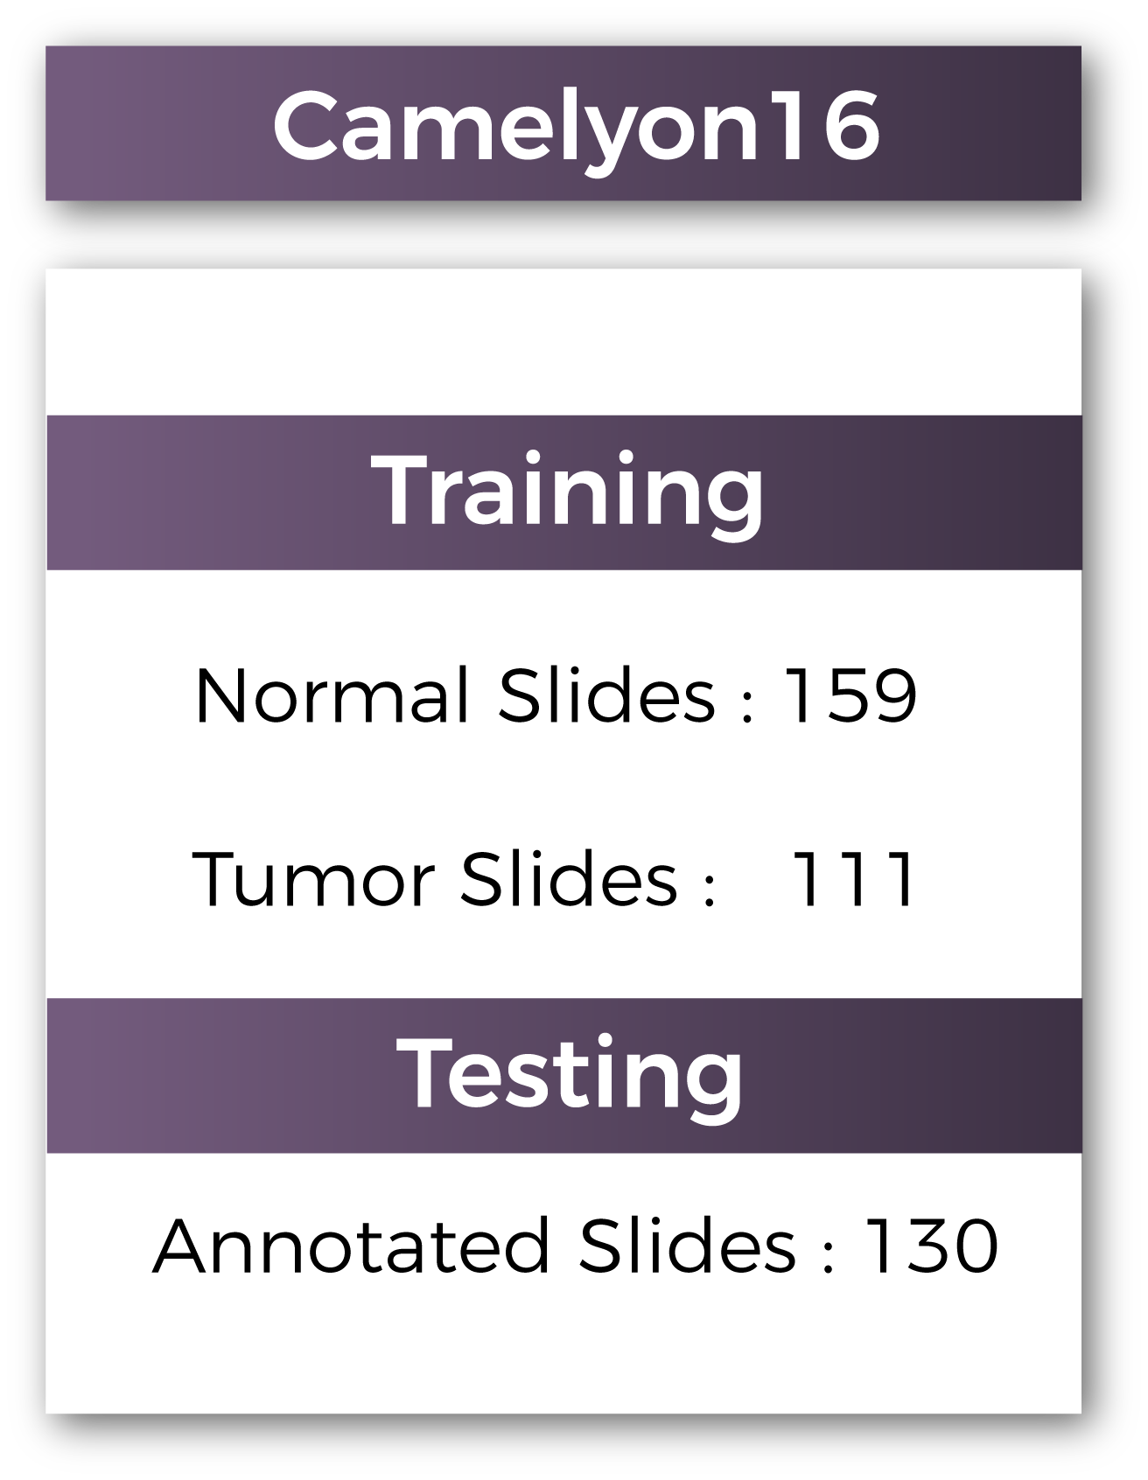
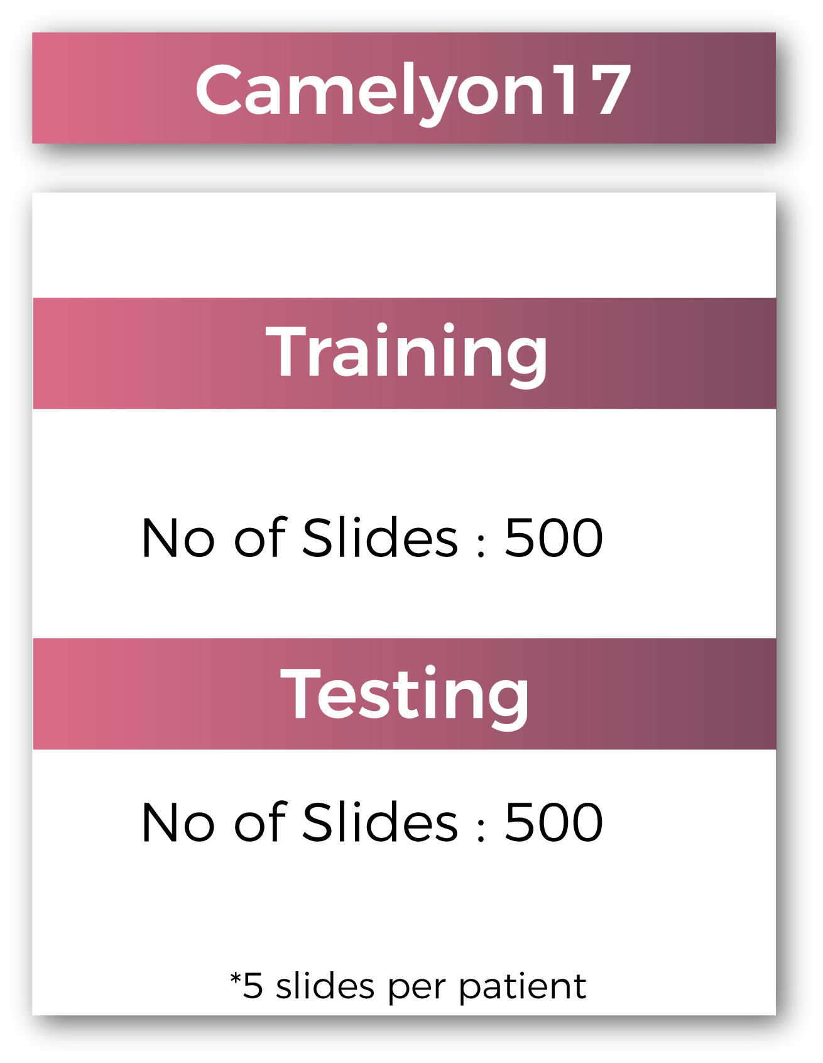
Data Set
https://camelyon17.grand-challenge.org/data/

Slide 14
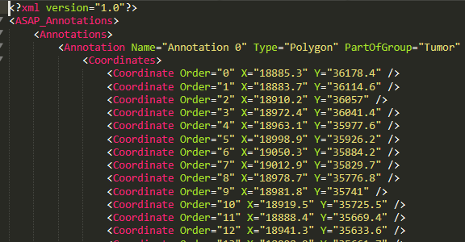
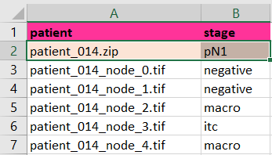
Data Set
Gigapixel slide images
Tif format
Image Size range: 1GB – 4 GB
Slide Level Annotations:
Given in xml format
List of polygons represented by vertices
Positive Polygons mean Tumor
Negative Polygons mean Normal
Patient Level Annotations:
Given in csv format
A stage label given for every patient
Slide metastasis level given for every node

Slide 15
Work Division
Usama Baig (Team Lead) | Pre processing & Local Testing, Patient Level Model Training & Modifications
Muhammad Mahad Khan | Patch Level Model Training & Modifications GUI Development
Khalid . | Pre processing, Post processing, GUI Development

Slide 16
PIPELINE

Slide 17


Region of Interest (ROI) detection with Image Procession
Training Phase
1
2
3
Region of Interest (ROI) detection with Image Procession
Train Deep ConvNet for tile-based classification
Training Data Construction
Testing Phase
1
Building Tumor Probability heatmaps using trained model
2
3
4
Determine cancer metastasis stage
Slide-based classification
Localization of tumor regions

Slide 18
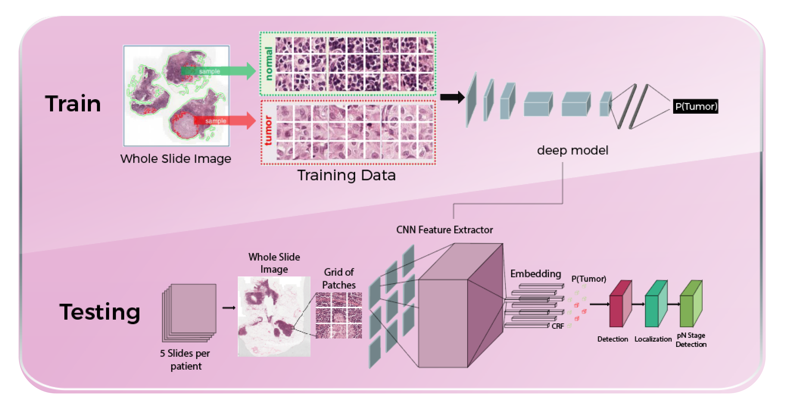
Our pipeline

Slide 19

1. ROI detection
Training Phase
Identify tissue within WSI
Exclude the white fat
Thresholding
Using Otsu Algorithm
In RGB space
Saturation in HSV space
Only 20% of WSI forms the tissue
Reduce computation cost and time

Slide 20
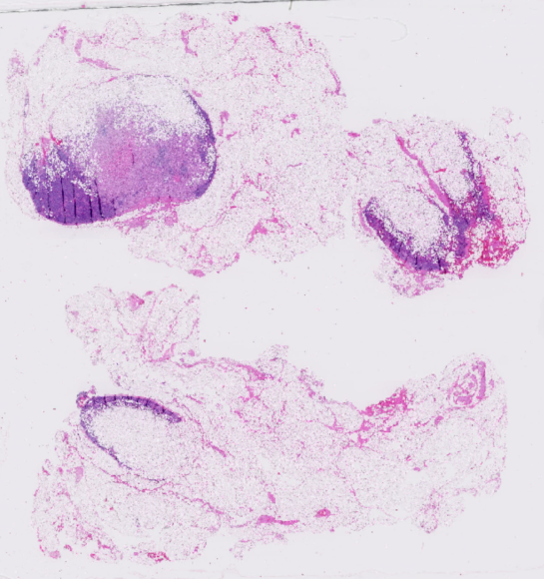
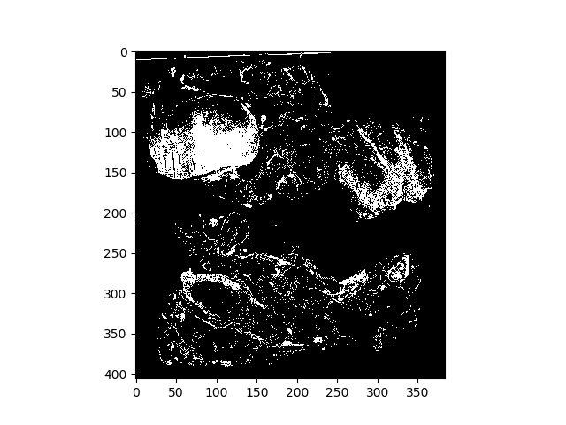


1. ROI detection
Training Phase
Original WSI
OTSU
Thresholding RGB
OTSU
Thresholding Saturation
Logical AND
Of both masks

Slide 21
2. Training Data Construction
Training Phase
Extract positive and negative tiles from ROI
Randomly extracted patches from ROI
To train our Deep ConvNet

Slide 22
2. Training Data Construction
Training Phase
Patch Dataset 1
Label | No. of Patches
Normal | 200,000
 | 20,000
Tumor | 200,000
 | 20,000
Patch Dataset 2
Label | No. of Patches
Normal | 900,000
 | 90,000
Tumor | 300,000
 | 30,000

Slide 23
Augmentations
Training Phase
Color Jitter
Brightness: 64/255
Hue: 0.04
Saturation: 0.25
Contrast: 0.75
Randomly Right or Left Flipped
Randomly Rotated by multiple of 90 degrees
Normalized
Centre Cropped
Source Google ppr

Slide 24
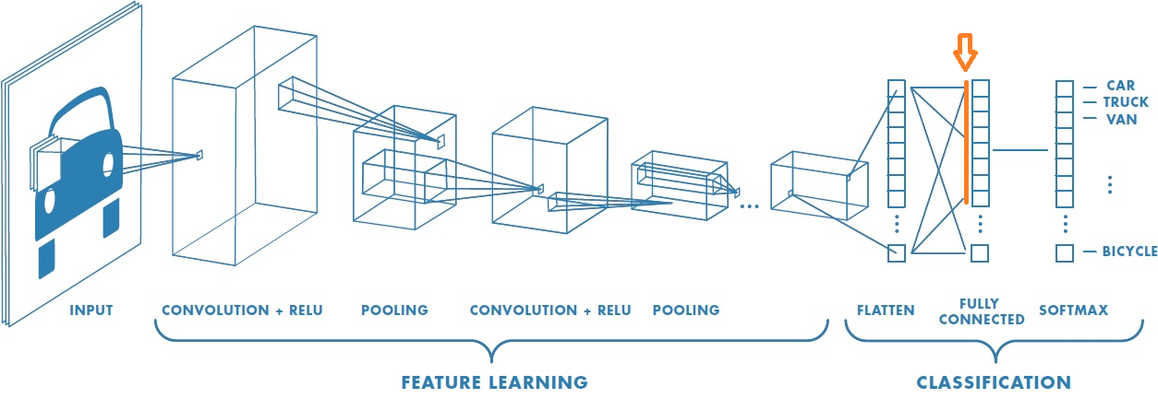
3. Train Deep ConvNet for tile-based classification
Training Phase
https://www.mathworks.com/solutions/deep-learning/convolutional-neural-network.html

Slide 25
3. Train Deep ConvNet for tile-based classification
Training Phase
Architecture | Number of Layers | Embeddings | Parameters
Inception ResNet v2-CRF | 467 + 1 | 1536 | 55.8 Million
ResNet-18 | 18 | 512 | 11.7 Million
ResNet-18-CRF | 18+1 | 512 | 11.7 Million
CataNet-CRF | 13+1 | 512 | 1.9 Million

Slide 26
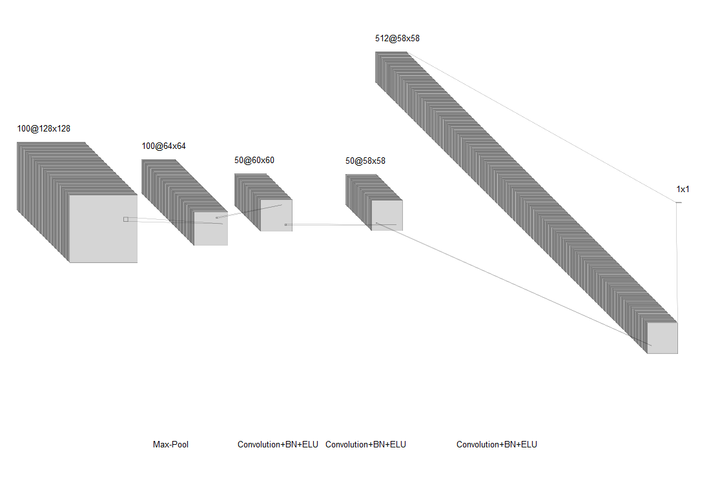
CateNet-CRF
Training Phase

Slide 27
3. Train Deep ConvNet for tile-based classification
Training Phase
Training Setup & Environment:
Transfer learning for Resnet’18 & Inception Resnet
Computations on Google Cloud Platform
CPU: 16 x 2.30GHz Intel
Xeon vCPUs
GPU: 1 x NVidia P100
RAM: 16GB Memory
HDD: 10 TB

Slide 28
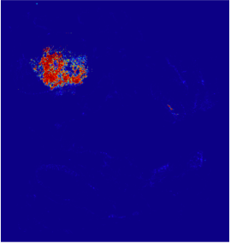
1. Building tumor probability heatmaps using trained model
Testing Phase
WHAT
HOW
Generate Tissue mask at level 6 (stride 64)
Build heat map using trained model
An image with each pixel containing value between 0 and 1

Slide 29
2. Slide-based classification
Testing Phase
Classify slide as positive or negative
By Reporting the maximum probability
Determines the Area Under Curve (AUC) Score

Slide 30
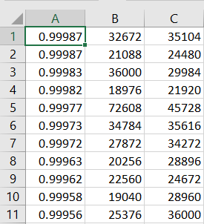
3. Localization of tumor regions
Testing Phase
Extract connected components
Report prediction through non maximum suppression
Using radius 12
Localize the tumors
Determines the Free-Receiver Operating Characteristic (FROC) Score

Slide 31
4. Determine cancer metastasis stage
Testing Phase
Predict the pN-stage of the patient
Find the micro and macro metastasis
Make prediction for the stage
Determine the Kappa’s Score

Slide 32
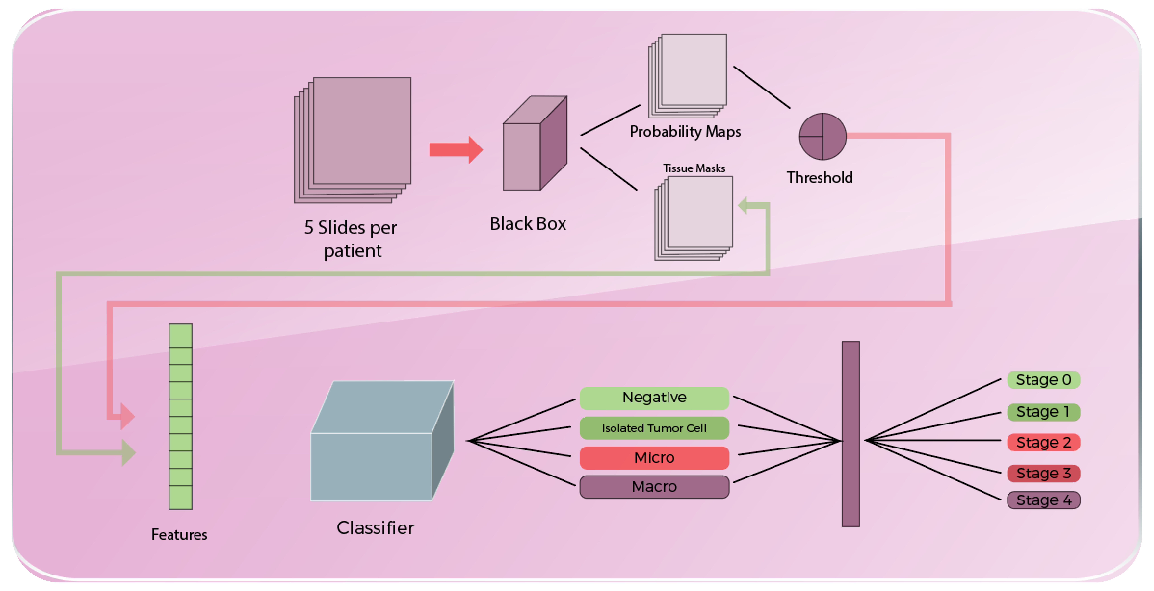
Pipeline for Stage Detection
Testing Phase

Slide 33
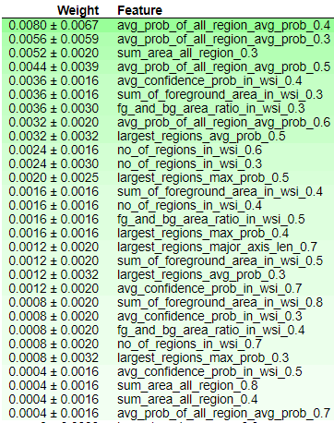
Extracted Features
Testing Phase
11 Hand crafted Features were extracted
At different Threshold levels (0.3-0.9)
Feature Details:
Largest region’s major axis length
Largest region’s maximum conﬁdence probability
Largest region’s average conﬁdence probability
Largest region’s area
Average of all region’s averaged conﬁdence probability
Sum of all region’s area
Maximum conﬁdence probability in WSI
Average of all conﬁdence probability in WSI
Number of regions in WSI
Sum of all foreground area in WSI
Foreground and background area ratio in WSI

Slide 34
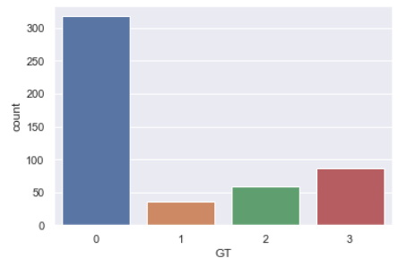
Constraint and Design Decision
Testing Phase
Severe Class imbalance problem
Negative : 318
Individual Tumor Cells (ITCs): 26
Micro-metastasis: 59
Micro-metastasis: 87
Hard to identify Individual Tumor Cells (ITCs)

Slide 35

Classifiers
Random Forest
Xgboost
Every sample had the same probability to appear in a new dataset
Reduced the variance
Good in identifying Negative slides
Model hyper-parameters:
N_estimators: 50
N_jobs = 2
Criterion = gini
min_samples_split = 2
Max_depth = None
Samples were weighted so some of them appeared more often
Reduced the bias
Good in identifying ITCs, Macro and Micro metastasis
Model hyper-parameters:
Max_depth = 3
Eta = 0.3
Objective = multi:softprob
Num_round = 20

Slide 36
Results

Slide 37
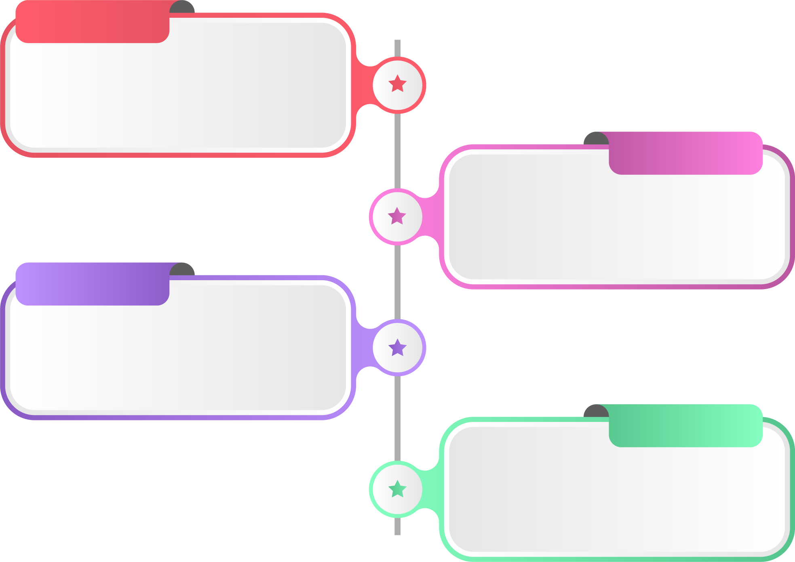
Metrics
Results
Receiver Operating Characteristic (ROC)
For Slide-based Evaluation
Sensitivity vs 1-Specificity
Free Receiver Operating Characteristic (ROC)
For lesion-based Evaluation
Sensitivity vs FPs per image
Kappa
For patient- level stage detection
Hypothesis Testing
Student’s T Test
Left Tailed P-value approach
https://camelyon17.grand-challenge.org/evaluation/

Slide 38
Results
Model | ResNet-18-CRF | Inception ResNet-v2-CRF | CataNet-CRF
Batch Size | 32x2 | 2x2 | 6x4
Image Size | 768 | 1023 | 1023
Patch Size | 256 | 341 | 341
Crop Size | 224 | 299 | 256
Learning Rate | 0.001 | 0.001 | 0.001
Momentum | 0.9 | 0.9 | 0.9

Slide 39
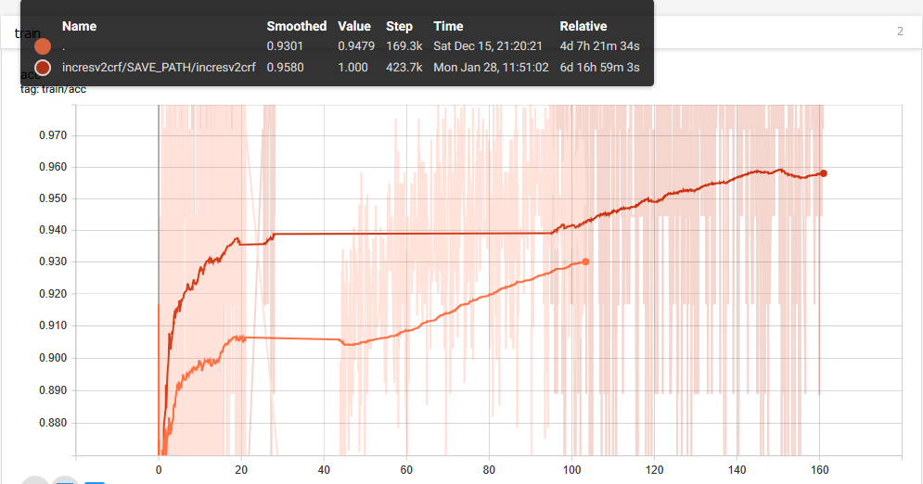
Results

Slide 40
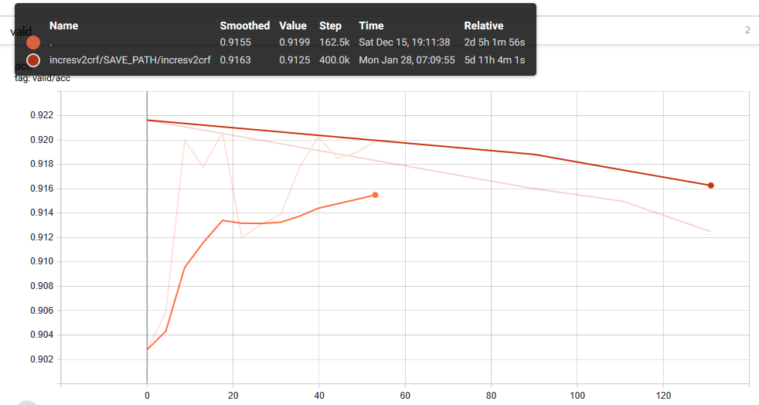
Results

Slide 41
Scores
Results
CNN Module
Architecture | Patch Training Accuracy | ROC (Detection) | FROC (Localization)
ResNet 18 | 92.42 % | 0.9644 | 0.7966
ResNet 18 CRF | 92.96 % | 0.9668 | 0.8075
ResNet 18 CRF + RF | 92.96 % | 0.9792 | 0.8075
Inception ResNet v2 CRF | 95.8 % | - | -
Patient Level Stage Detection (using Resnet-18 as CNN Module)
Classifier | Kappa (Localization)
Random Forest | 0.8345
XGBoost | 0.8075
Ensemble | 0.8749

Slide 42
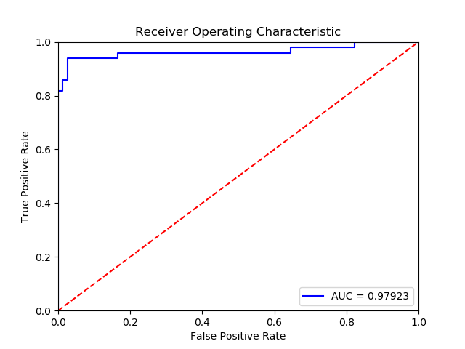
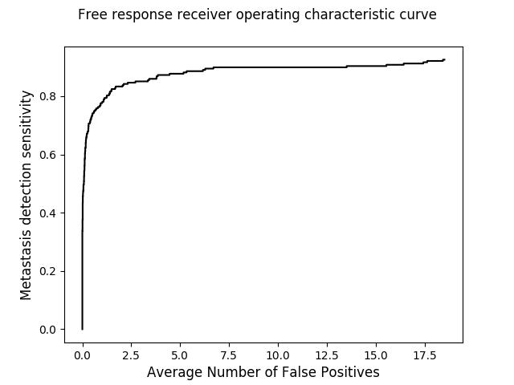
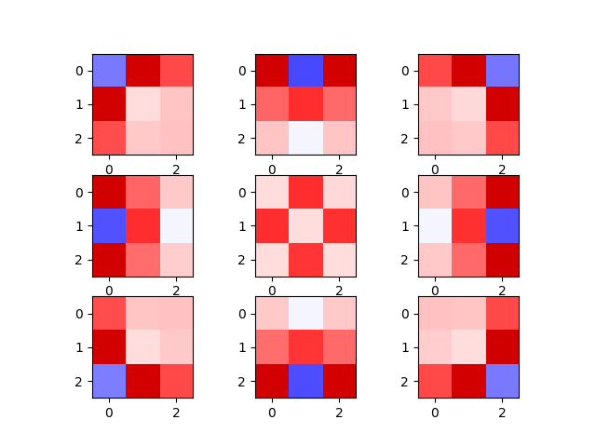
Plots
Results
AUC-Score
FROC
W in CRF

Slide 43
Comparison
Results
Architecture | Details | ROC (Tumor Detection) | FROC (Tumor Localization) | FROC @ 8FP per Slide | Kappa (Stage Classification)
Team CataNet | 1 CNN Module Stride of 64 | 0.9792 (0.9677,0.9984) | 0.8075 | 0.8991 | 0.8749
Team Google | Ensemble of 3 CNN modules | 0.986 | 0.8601 | 0.911 | -
Team MIT & Harvard | Stride of 4 | 0.994 | 0.827 |  | -
Human | 30 hours per slide | 0.966 | 0.733 | 0.733 | -

Slide 44
Fail Again, Fail Better!
Results
Model 1
Accuracy 88.3
Dilated ResNet Accuracy 89.1
Local-Global Context
Network
Accuracy 85.6

Slide 45
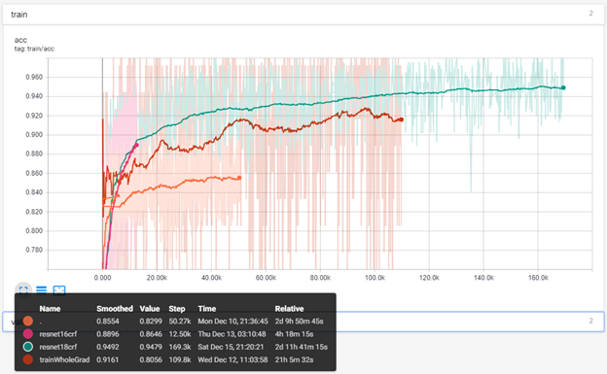
Fail Again, Fail Better!
Results

Slide 46
Conclusions & Recommendations

Slide 47
Conclusions and Recommendations
Improving Patient Stage Module accuracy
Solve class imbalance problem by increasing tumor slides
Include dataset from different centers
Improve the probability maps generated by CNN Module
Slide Label | Accuracy
Negative | 89 %
ITC | 30 %
Micro | 87.5 %
Macro | 97.3 %

Slide 48
Conclusions and Recommendations
Improving Slide-level accuracy:
Increase number of patches
Sample more non-tumor patches than tumor patches
Repetitive hard-mining with a more trained network
Upscale in last two layers and use CRF

Slide 49
Conclusions and Recommendations
Improving CNN Module accuracy
Make predictions at a smaller level
Level 4 used by MIT team (16 Time Computation overhead)
Take Average of predictions at patch level by rotating and flipping
Use Ensemble method
Resnet-18
Resnet-34
Inception-Resnet-v2
Increase the dataset of patches for training the CNN Module

Slide 50
Timeline
Phase | Expected Date
Project Case Study | May’18
Literature Review | June’18
Data Set and Pre processing | Oct’18
Slide Level Module | Dec’18
Post Processing | Jan’18
Patient Level Module | March’18
Final Testing and Tuning Phase | April’18

Slide 51
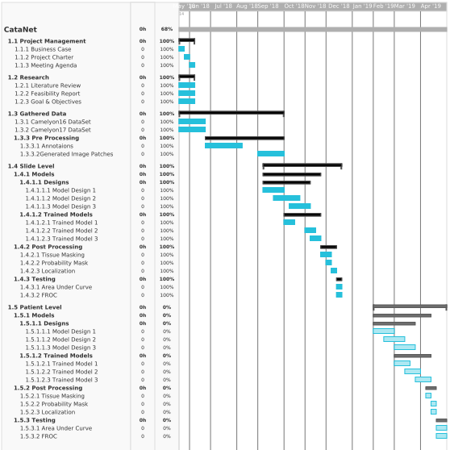
Timeline

Slide 52
THANK YOU! Suggestions/Questions?

